Slide 1


Genuino 101 AirOwl
Smart Air Quality Monitor
Sohil Patel
Jayso Labs, India
Intel ISEF
Educator Academy Phoenix, Arizona
May 8-13, 2016

Slide 2

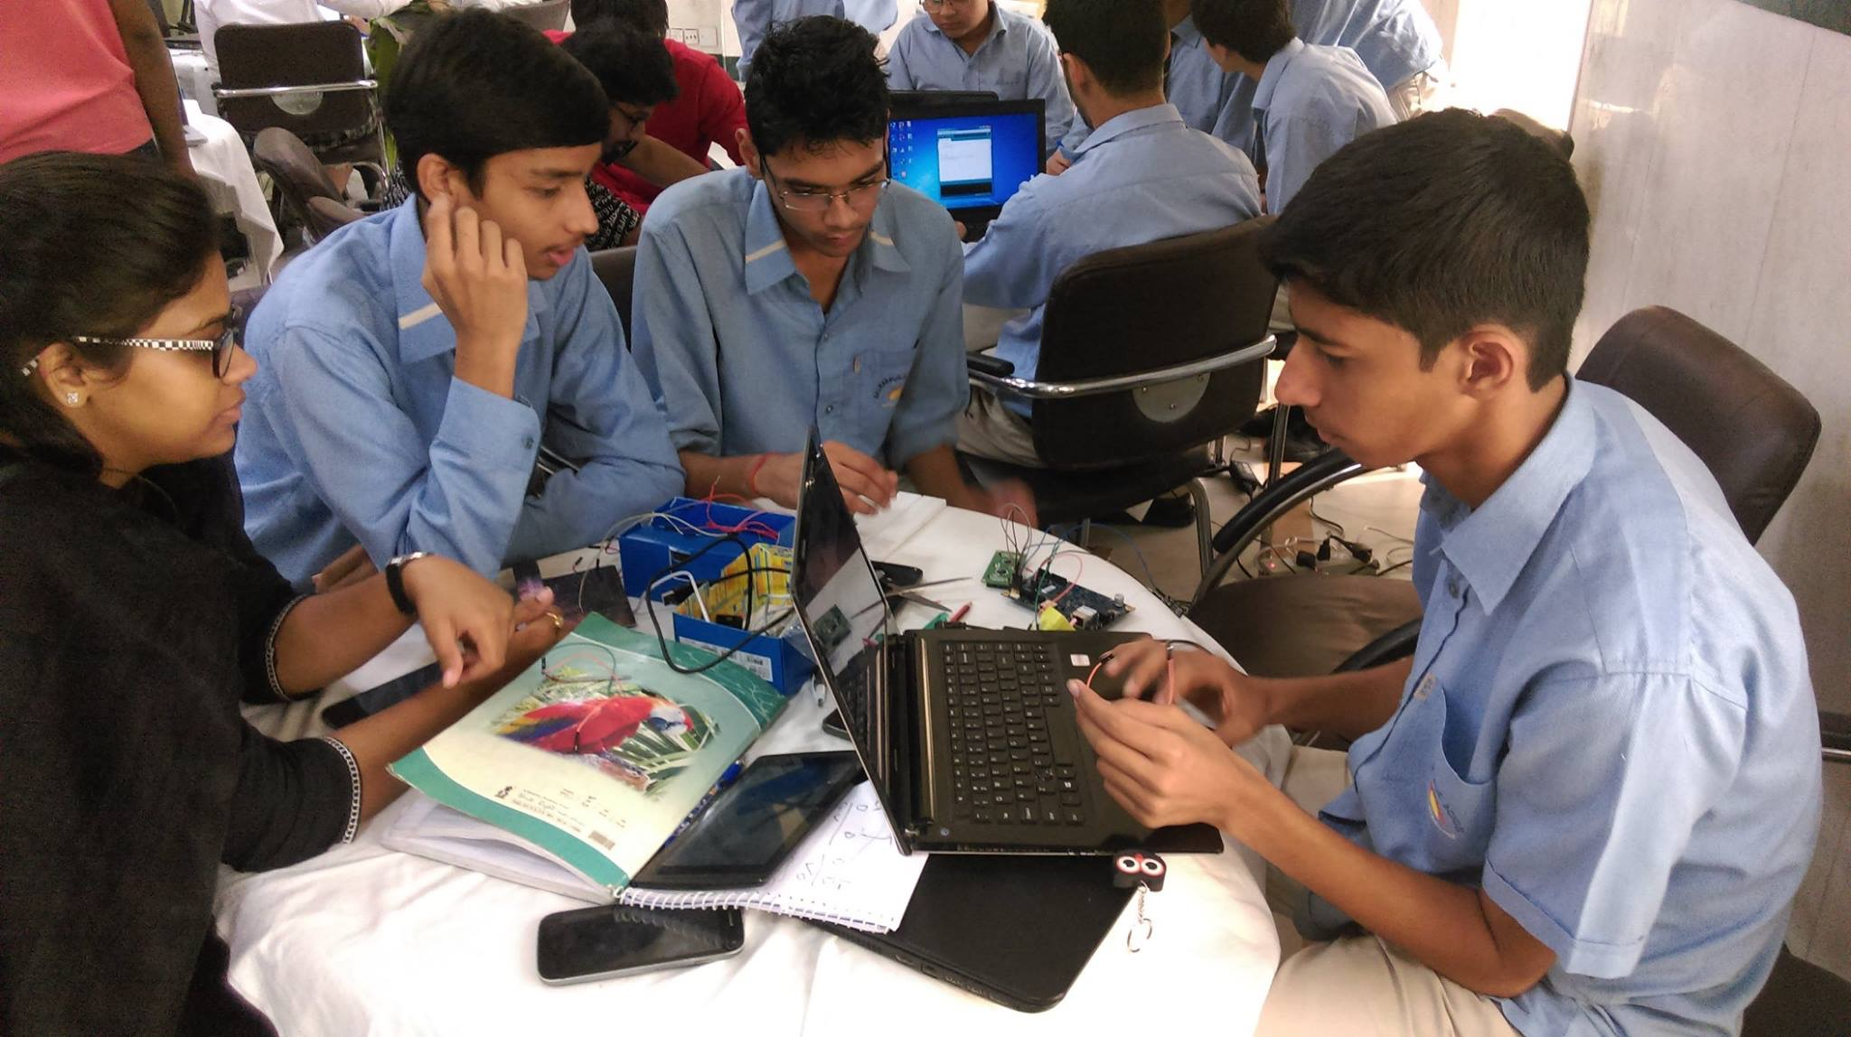
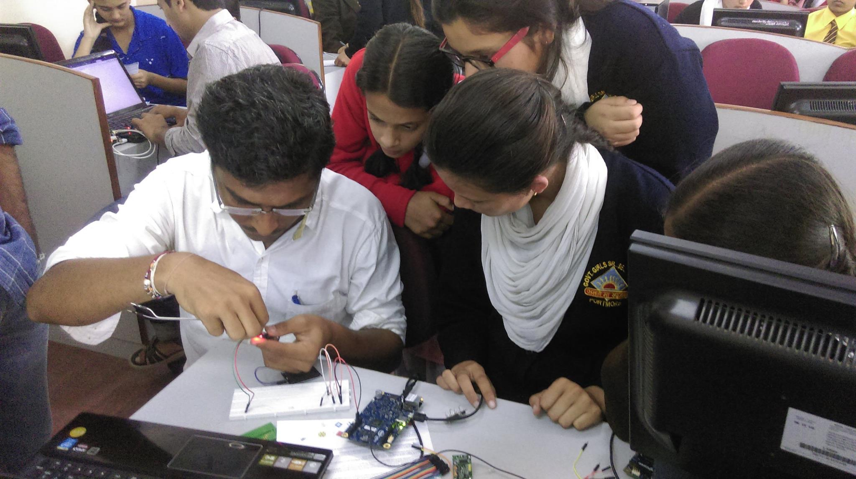
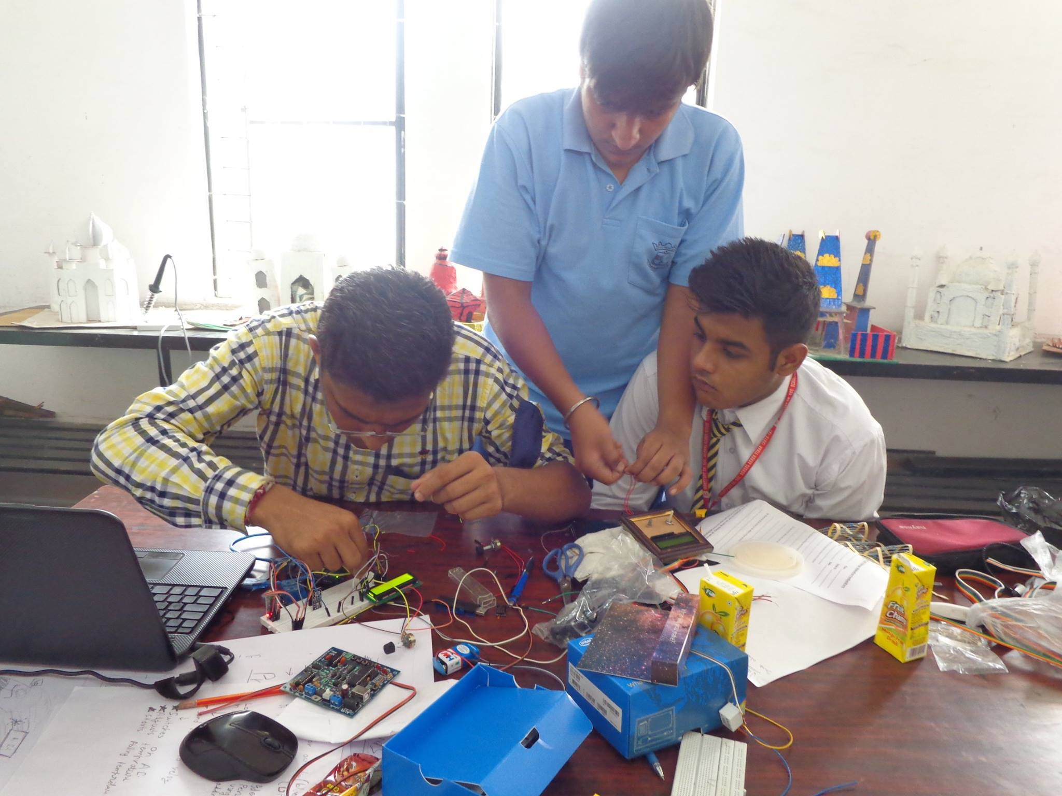
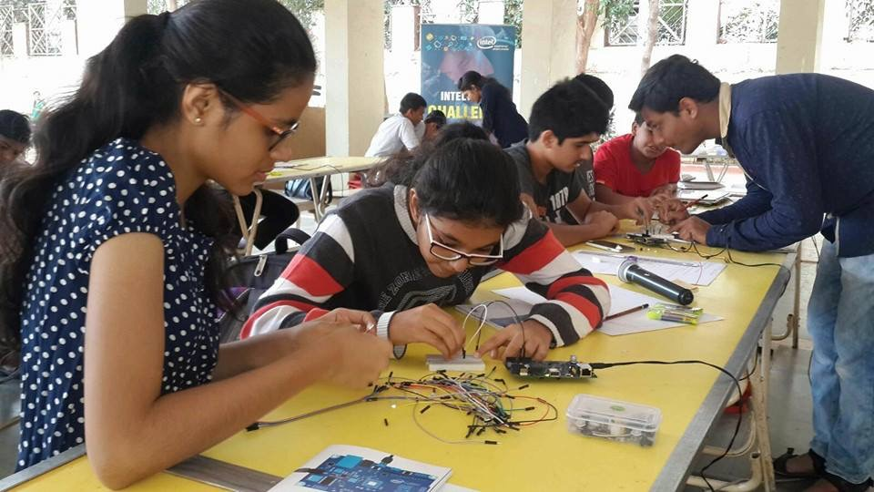
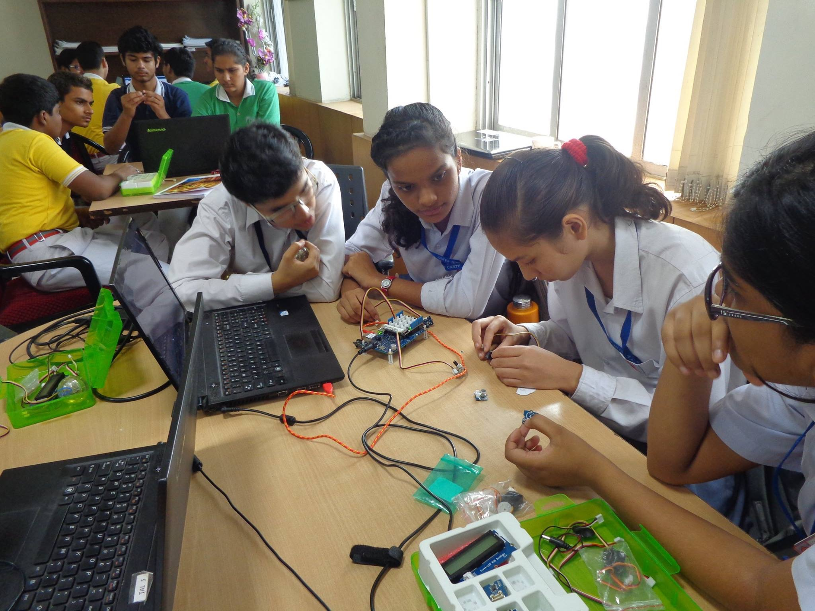
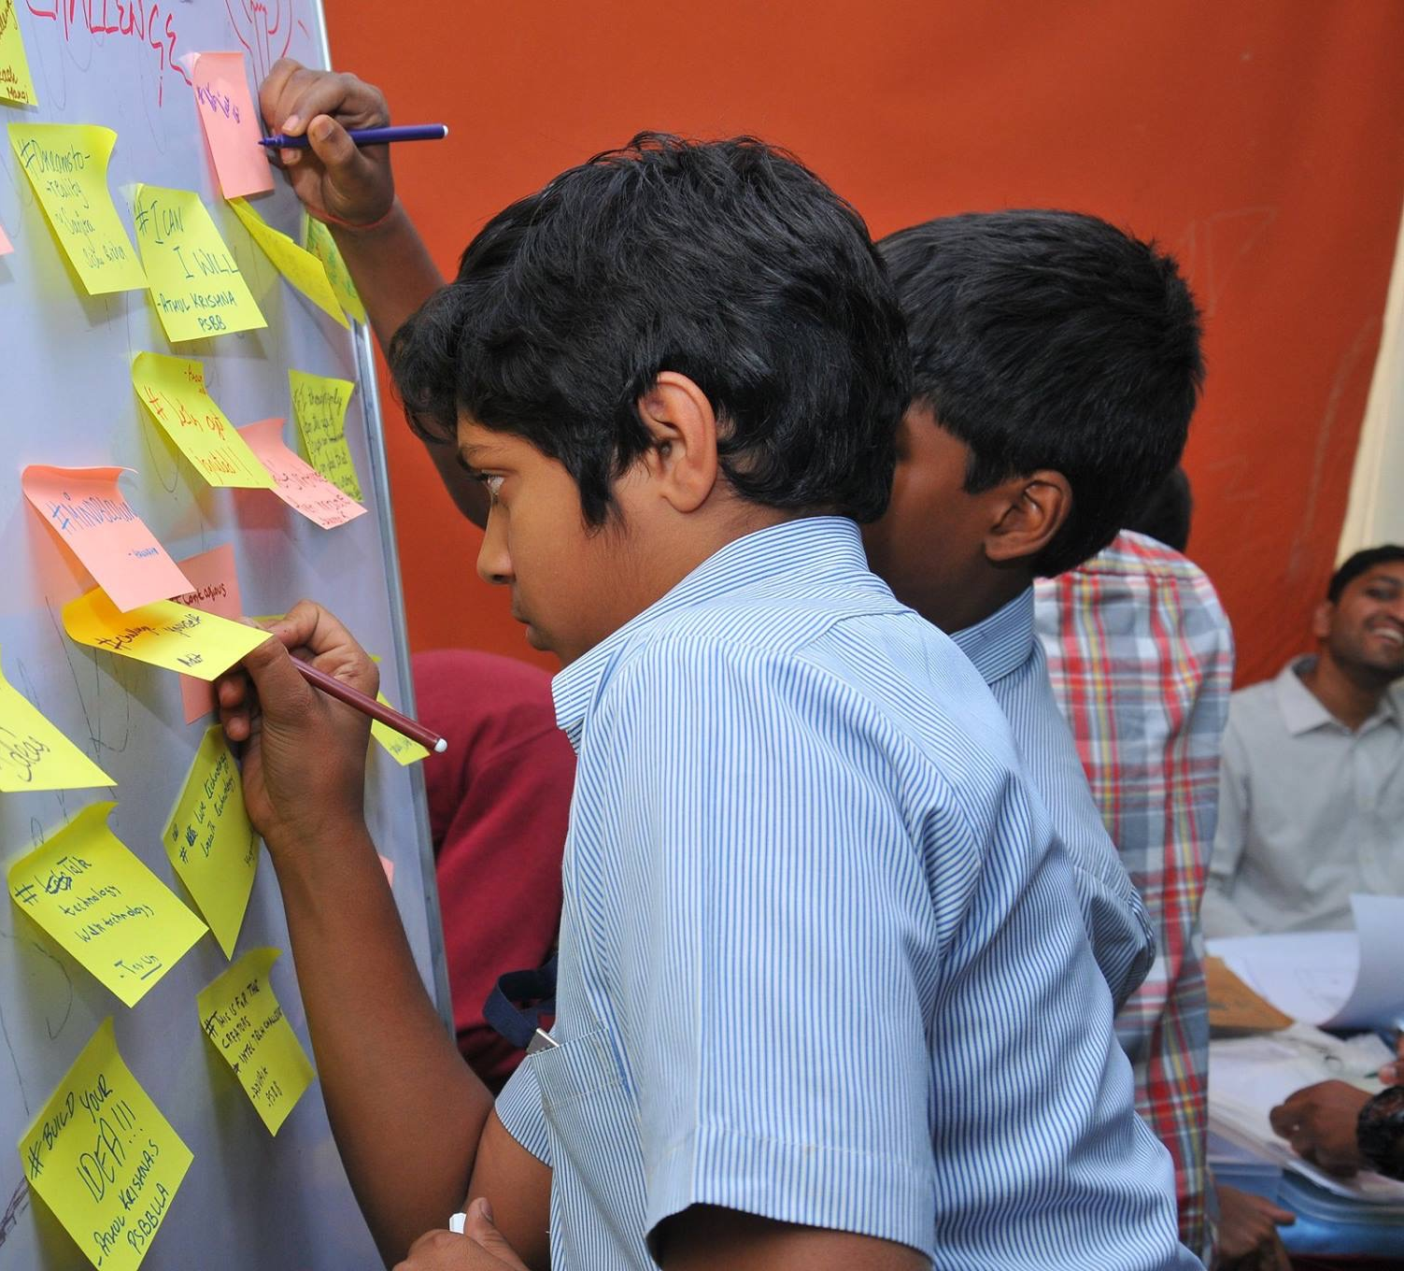
DIY Approach

Slide 3
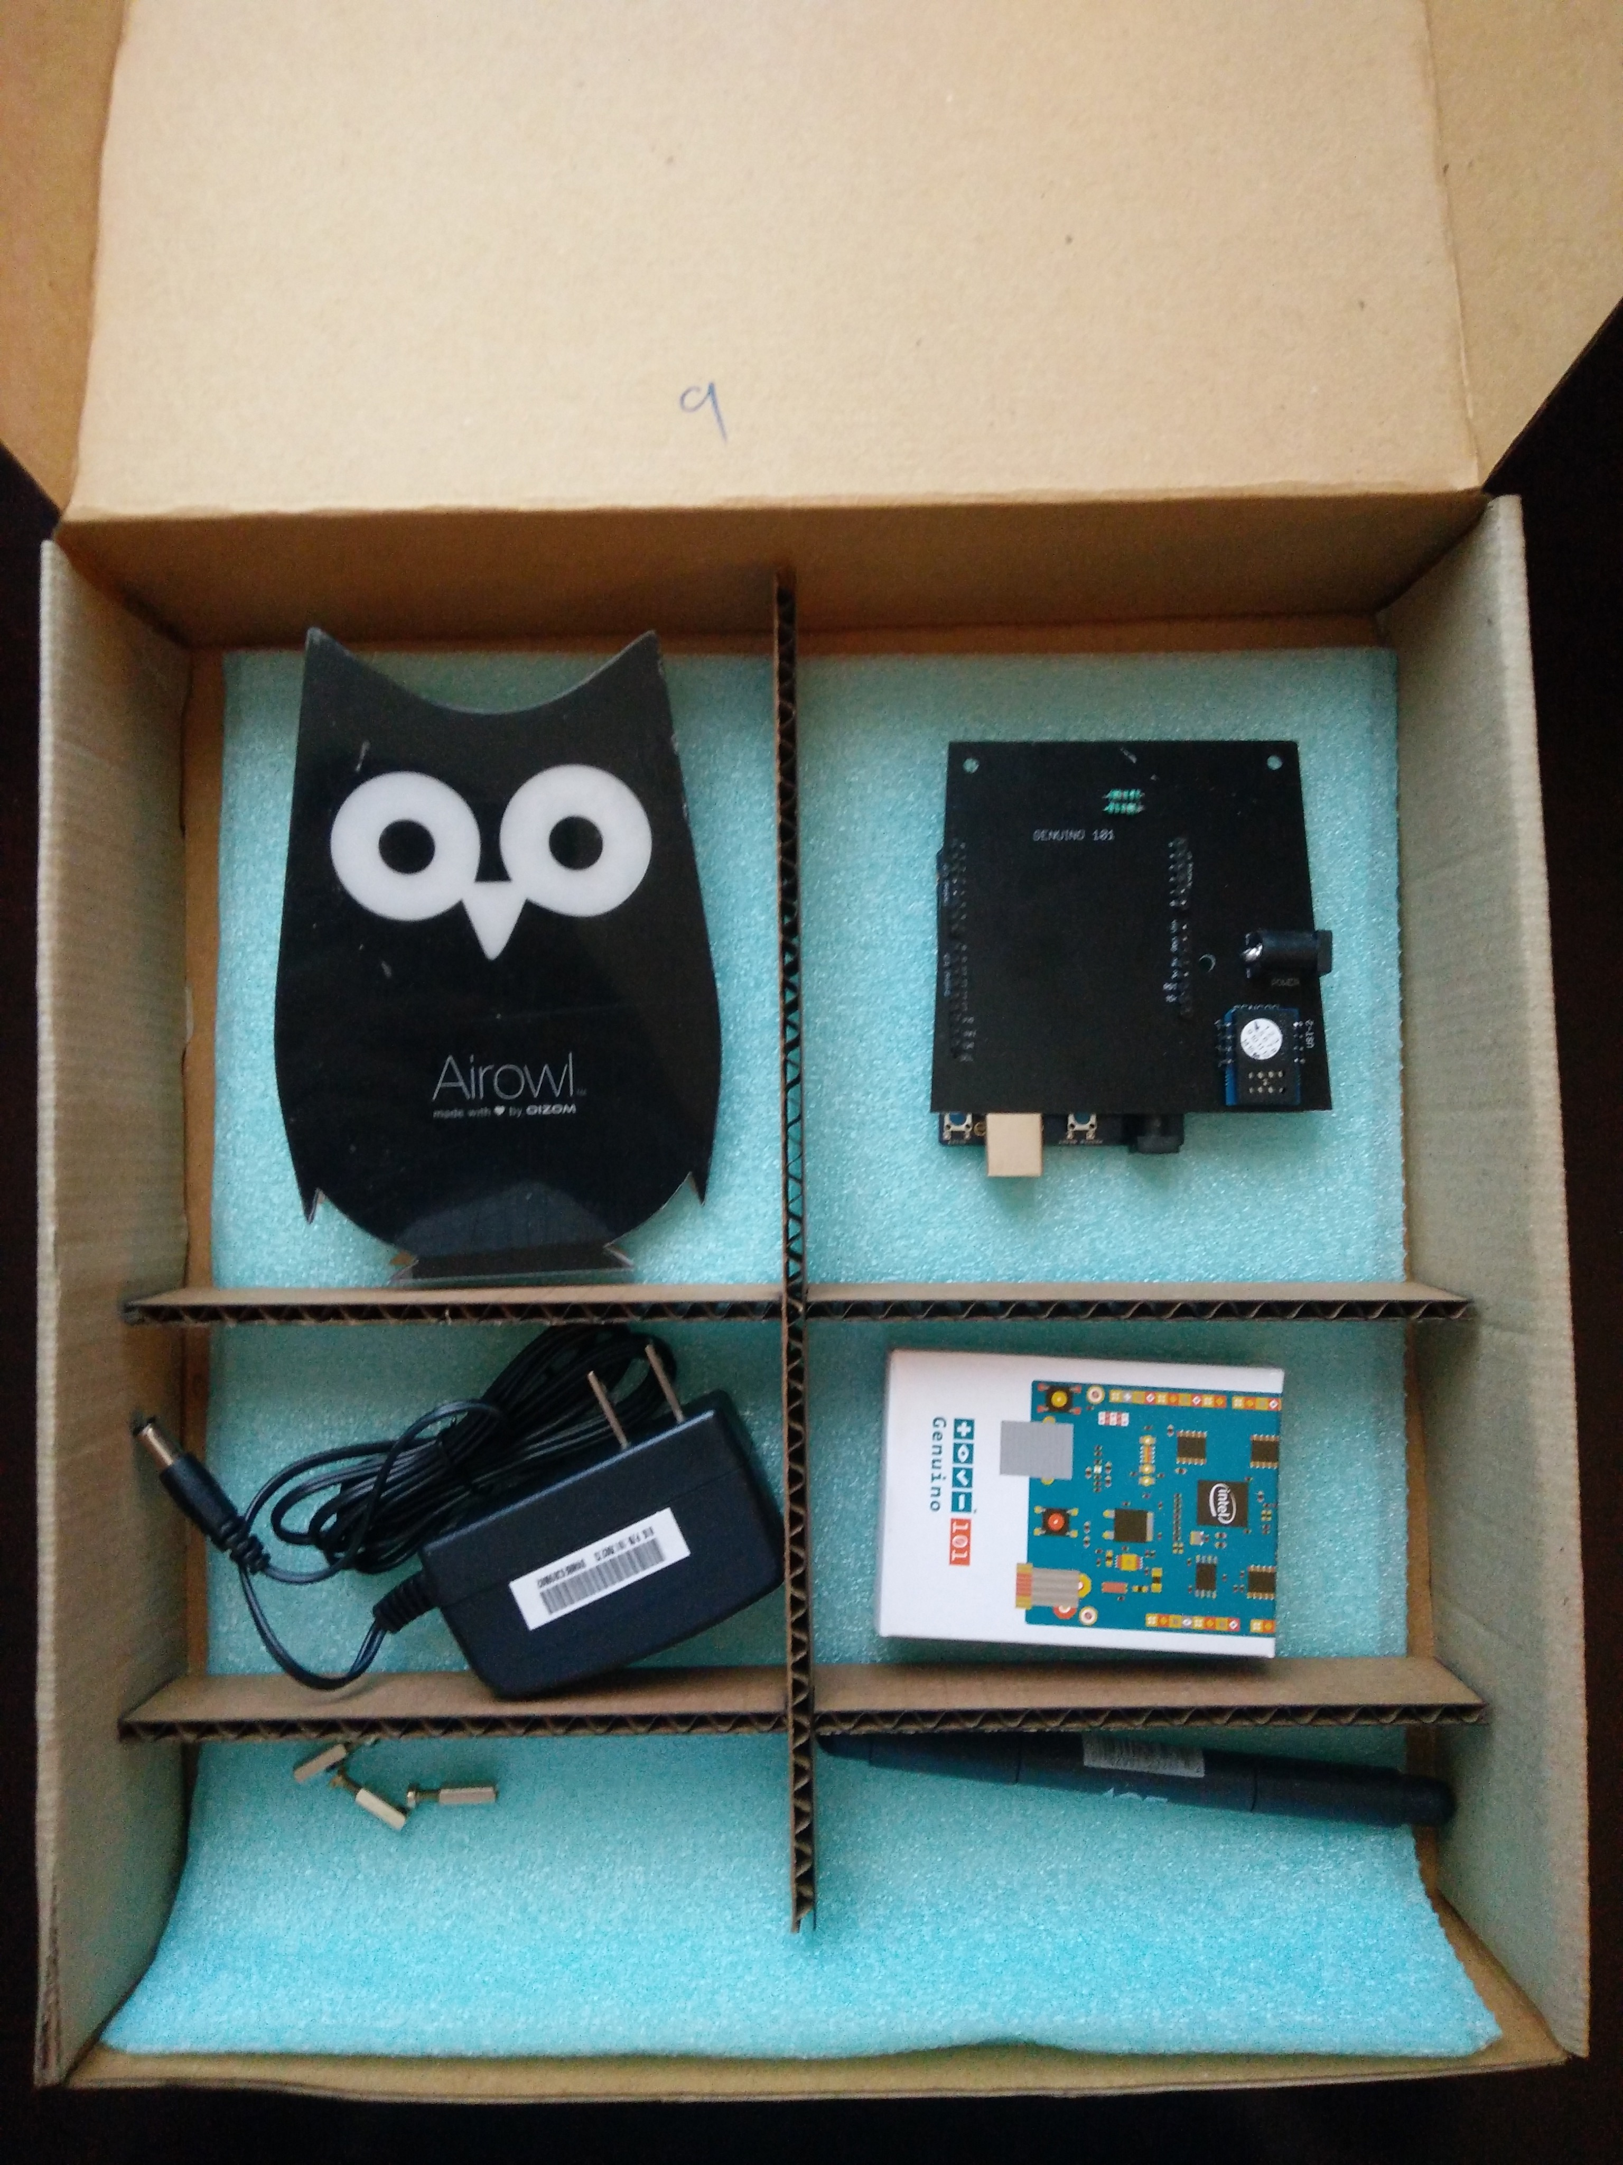
What is AirOwl ?
AirOwl is a DIY Air-Quality Monitor powered by Genuino 101 which detect toxicity in the air around you and send the data to your personal device using Bluetooth

Slide 4
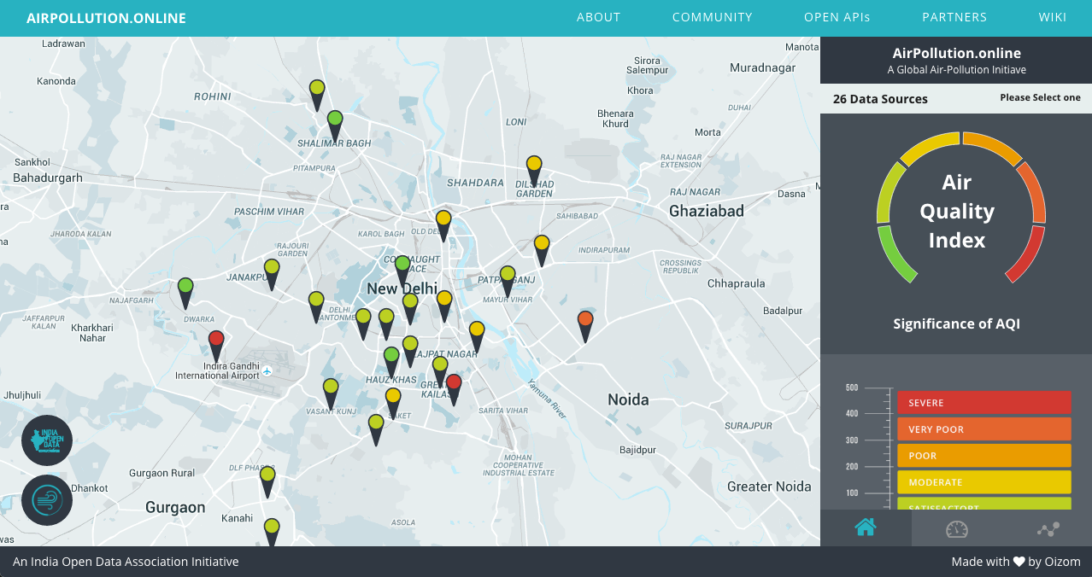
Why AirOwl ?
Community driven problem solving approach

Slide 5
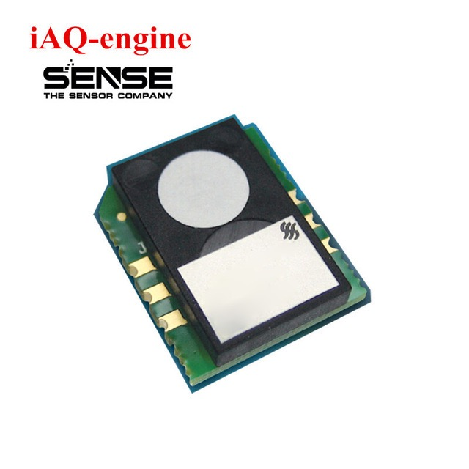
Sensors
A device that detects or measures a physical property and records, indicates, or otherwise responds to it.
IAQ Sensor
Indoor Air Quality Monitor Sensor
based on Mic-Nose technology
detects VOC gases
detects CO2 saturation
Alcohol, CO, hydrocarbons

Slide 6
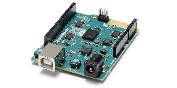
Arduino 101
A learning and development board that delivers the performance and
low-power consumption of the Intel® Curie™ Module with the simplicity
of Arduino at an entry-level price.
The board recognises gestures, and features a six-axis accelerometer and gyroscope
Control your projects with your phone over Bluetooth connectivity

Slide 7
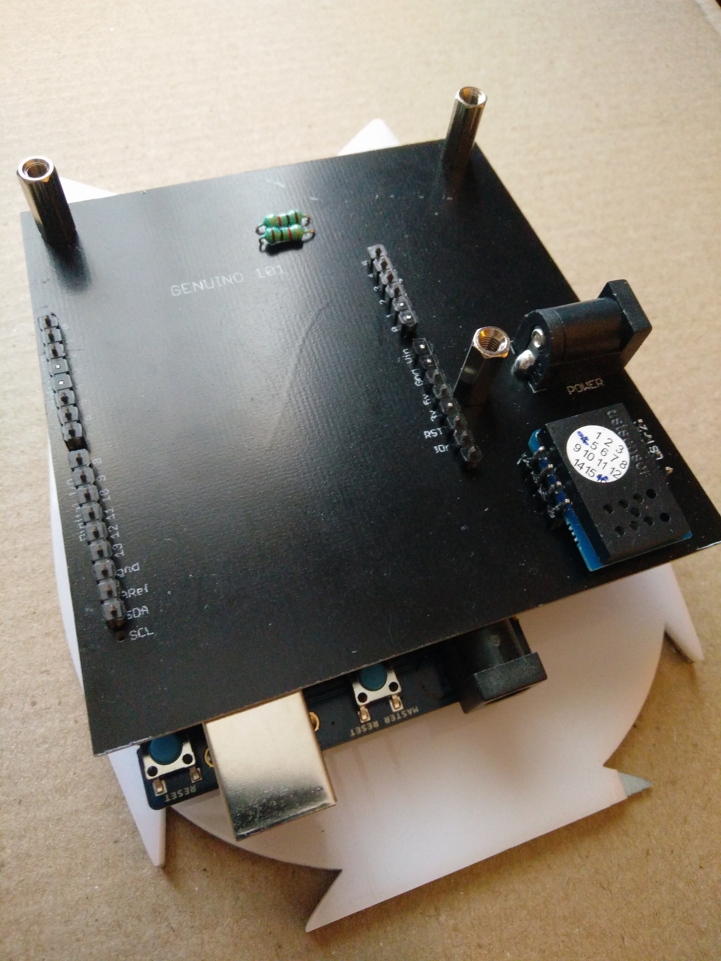
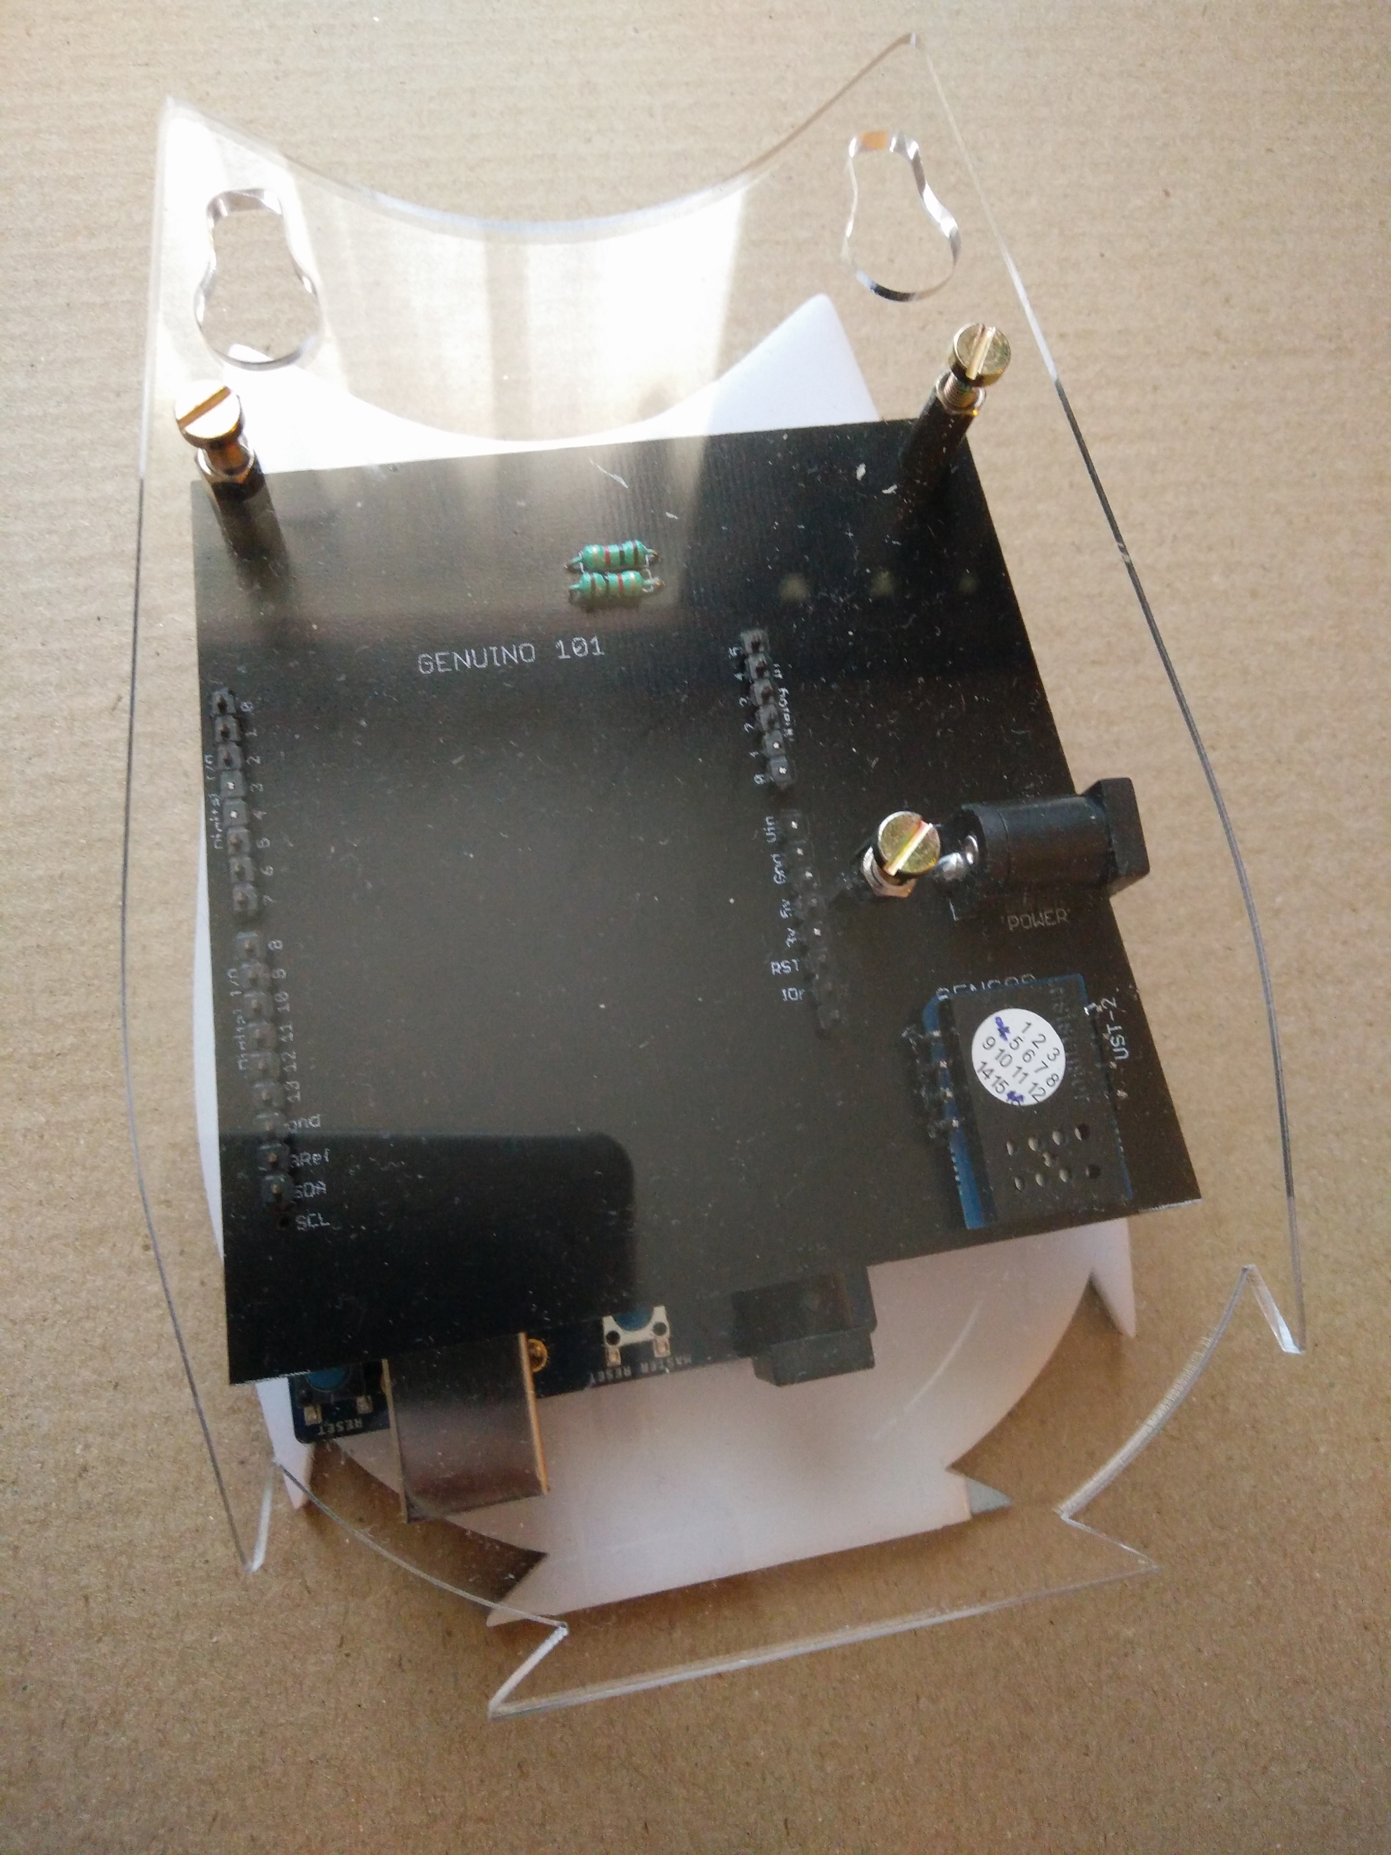
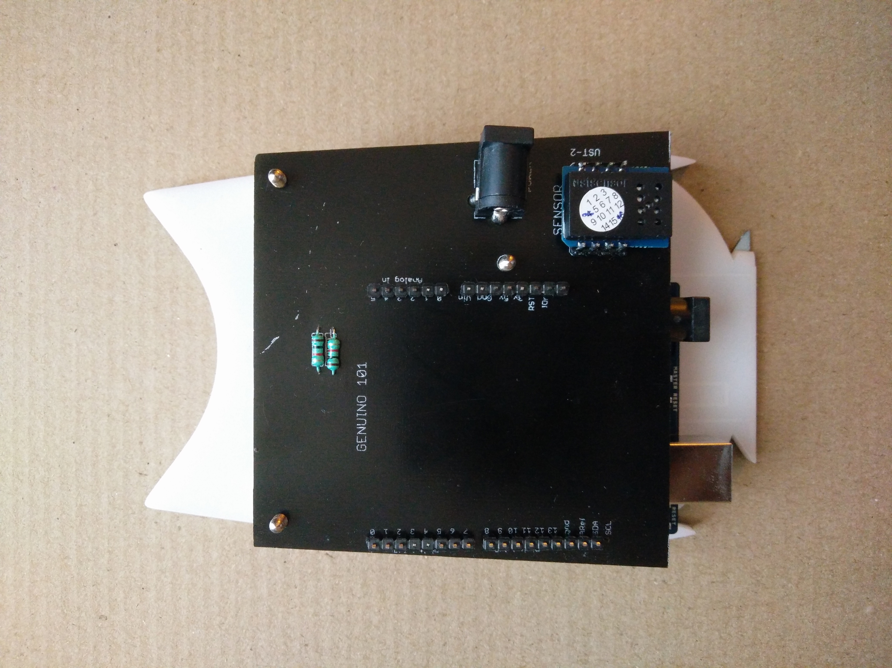
Assemble Electronics
STEP 1
STEP 2
STEP 3

Slide 8
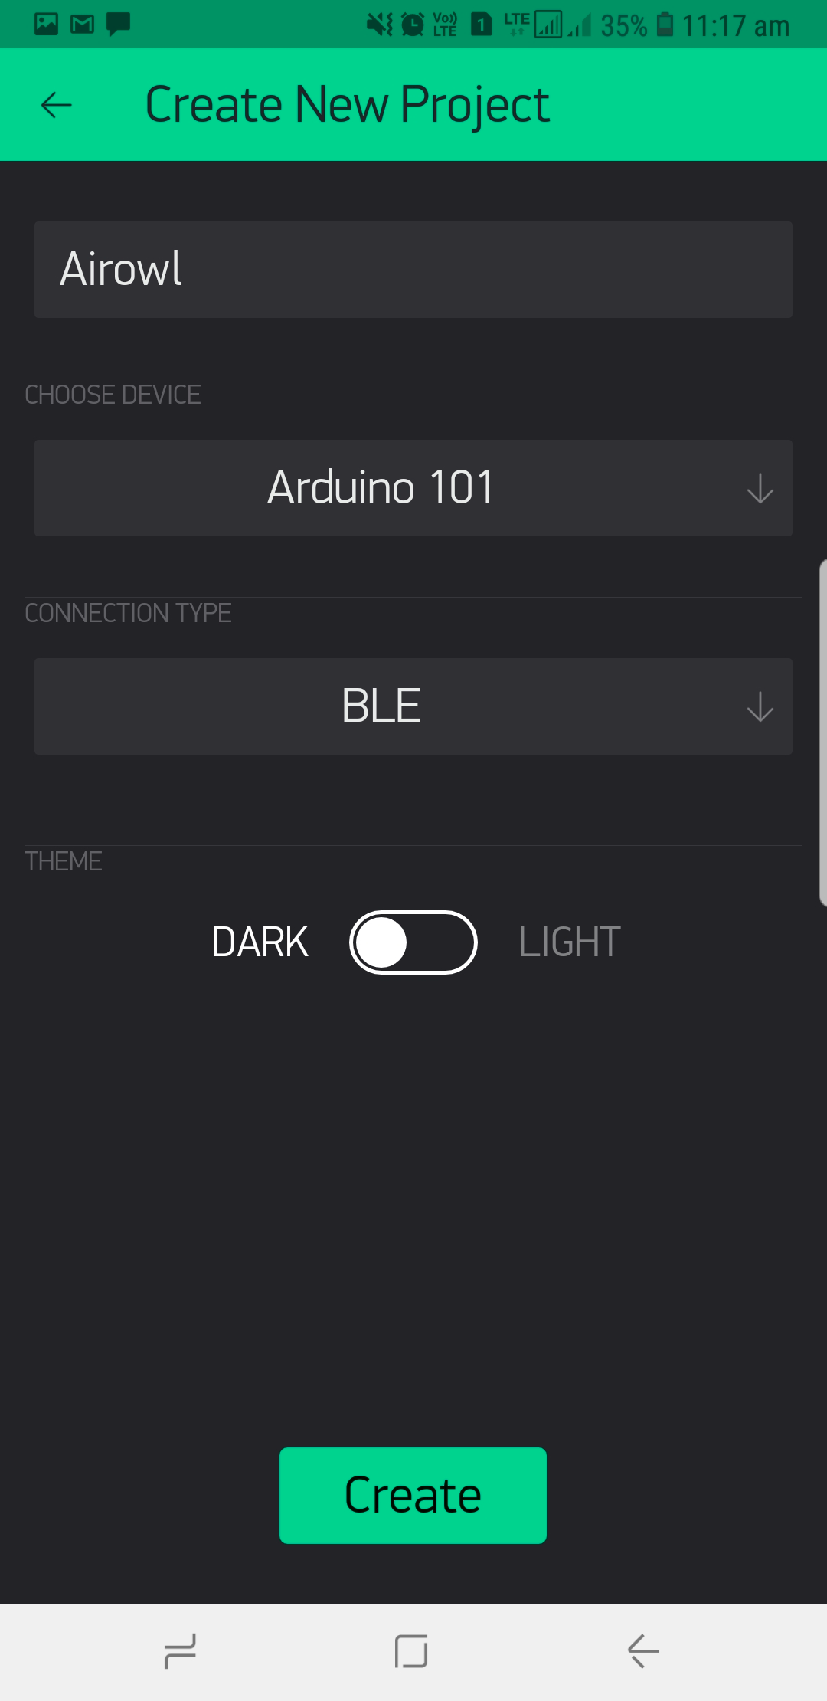
Let’s build our app(1)
Step 1 :Download App from App store or Play Store (Blynk)
Step 2 : SignUp and Login to Blynk
Step 3 : Click on New Project
Step 4 : Enter details as mentioned in picture
Step 5 : You will receive your authentication token in registered mail

Slide 9
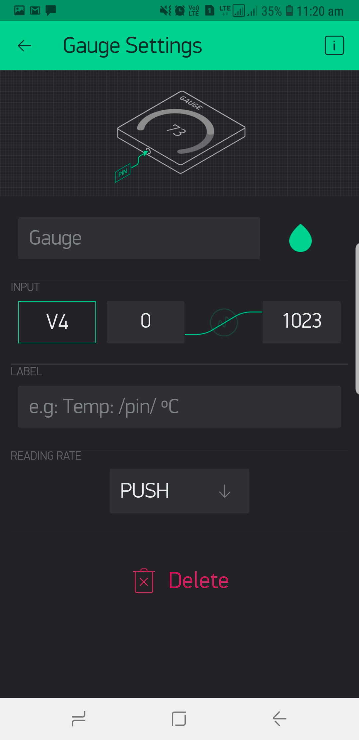
Let’s build our app(2)
Step 6 : Click on Add button on top right corner
Step 7 : And click on Guage
Step 8 : Now click on that Gauge appeared on your screen
Step 9 : Set PIN --> V4
Step 10 : Woah! You built your app

Slide 10
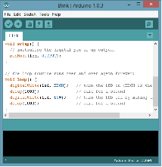
Program your Owl
Step 1 :Download AirOwl code from : tinyurl.com/Airowl
Step 2 : Open this code and give name to your own AirOwl at line 26 and 27
Step 3 : Paste your Authentication key on line 20 (Blynk Auth key)
Step 4 : Connect Genuino to your computer and upload the code

Slide 11
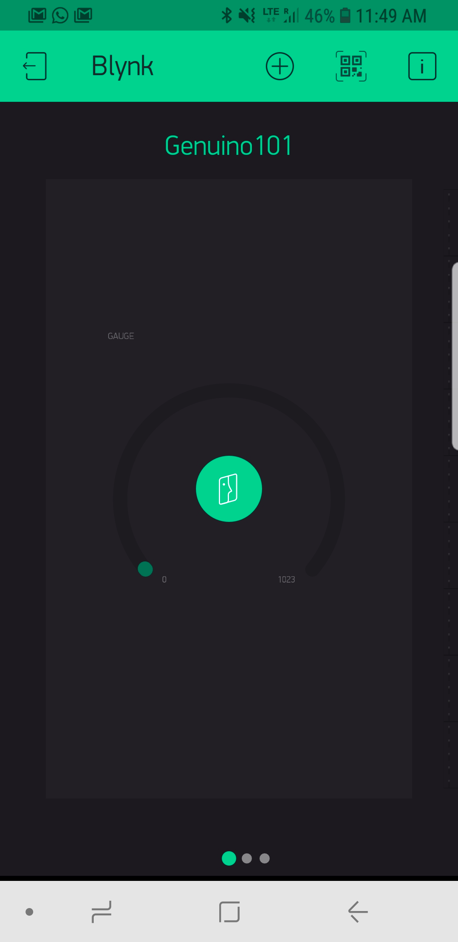
Final Steps
Step 1 : Now connect to bluetooth device and open Blynk
Step 2 : Click play button on top right corner
Step 3 : Huh! Enjoy!

Slide 12
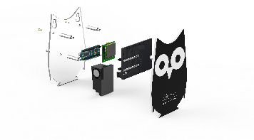
Test your Owl
https://github.com/oizom/AirOwl

Slide 13
Thank you for participating in the 2016 Intel ISEF Educator Academy
Sohil Patel
sohilpatel4932@gmail.com
Anith Patel
patelanith01@gmail.com

Slide 14
Copyright © 2014 Intel Corporation. All rights reserved. Intel and the Intel logo are trademarks of Intel Corporation in the U.S. and other countries. *Other names and brands may be claimed as the property of others.

